Slide 1

Sentiment analysis on US election twitter data
Presented By:
Fathima Syeda & Ayushi Shrivastava

Slide 2
AGENDA
Introduction
Motivation
Methodology
Data Collection
Data Preprocessing
Tweet Classification
Working
Output
Conclusion
References

Slide 3
INTRODUCTION
About Twitter
Social Networking Application having microblogging services.
Gives the facility of send and receive short posts.
The maximum length of tweets could be 140 characters.
What is Sentiment Analysis?
Sentiment analysis is the process of classifying the polarity of any given text in sentence or a phrase. It helps to determine whether the opinion brought in front in the form of text is neutral, positive or negative.

Slide 4
Motivation
The main motive behind using Twitter data is that it includes rich structured information about each, and every individual involved in the communication
It also leads to accurate tools for extracting semantic information.
Pre-written classifier code in python can be used in order to promote research which will lead to how sentiments is communicated in tweets.

Slide 5
Methodology
DATA COLLECTION
To perform the sentimental analysis, we need the Twitter data which consist of all the tweets related to any specific keywork. The keyword used here in this project is “Joe Biden” and “Donald Trump”.
Dataset consists of around 900k tweets for trump and 700k for Biden

Slide 6
Tweet Classification
DIFFERENT WAYS OF CLASSIFICATION OF DATA
Binary Classification: Here the tweets are classified into two categories i.e., positive and negative.
3-Tier: Here the tweets are classified into three categories i.e., positive, negative and neutral.
5-Tier: The tweets are classified into 5 categories i.e., neutral, extremely positive, positive, extremely negative, negative.

Slide 7
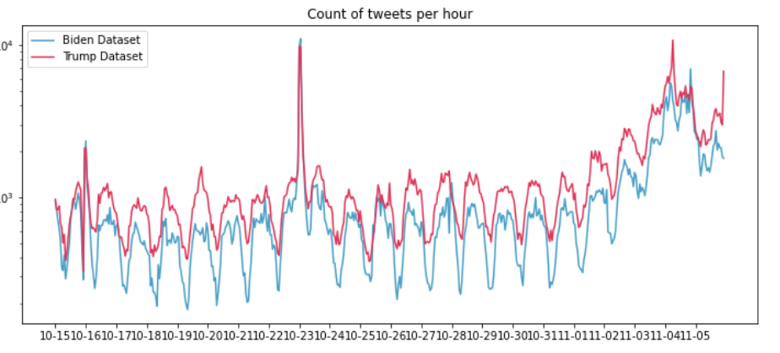
Exploring the Data
Most tweets with geodata info are form America
There was regularity for tweets per hour pattern for both candidates
As the elections approached the num tweets increased

Slide 8
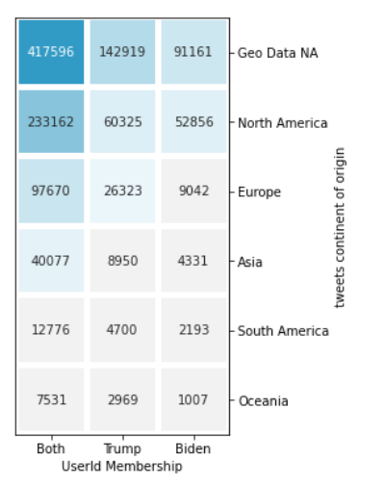
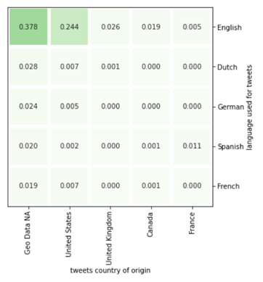
Preprocessing
On a sample of 4000 the heatmap shows the top 5 languages used and the top 5 countries that they were tweeted from
Most tweets with geodata info are form America

Slide 9
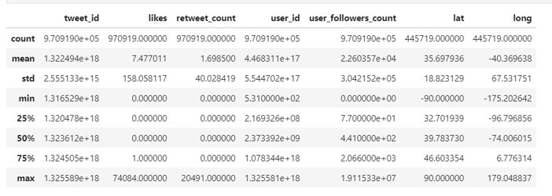
Preprocessing
We get the retweet_count ,liked from extended Tweets json object
Lat, long form the geo_location dataset from USA.
We drop those tweets that have null values for our required fields.
Also remove stop words, Lemmatize the words of th tweet text

Slide 10
Sentiment Analysis (VADAR)
VADER (Valence Aware Dictionary and sentiment Reasoner) package, which is a lexicon and rule-based sentiment analysis tool
specifically tuned to sentiments expressed in social media
sensitive to both polarity (positive/negative)
relies on a dictionary that maps lexical features to emotion intensities known as sentiment scores.
Imported from nltk and can be applied directly to unlabeled text data.

Slide 11
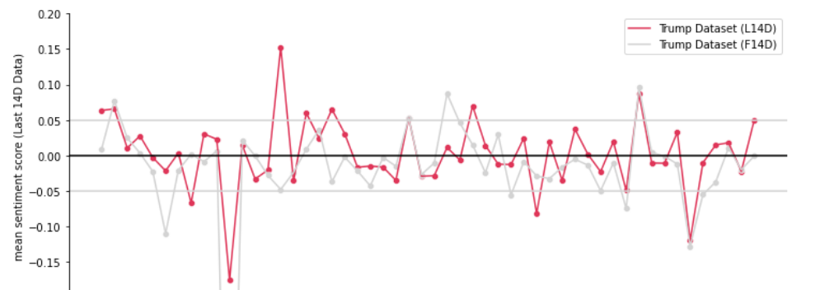
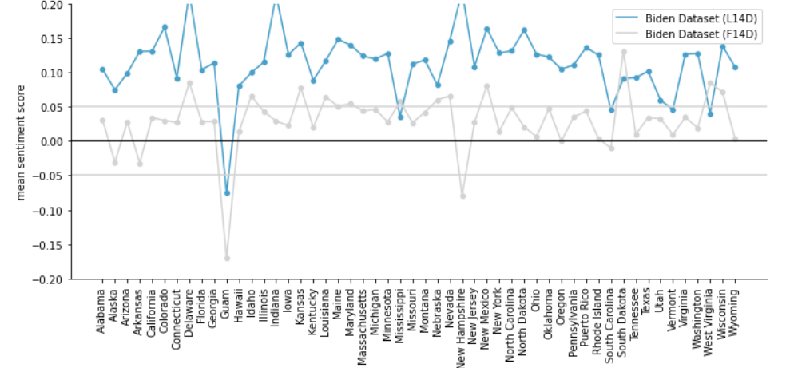
Sentiment Analysis compound score
The VADAR analysis produces a compound score
We visualized the mean compound score for the first and the last 14 days
most states had positive sentiment score for democrats
And neutral sentiment score 0.05 and -0.05 for republicans

Slide 12
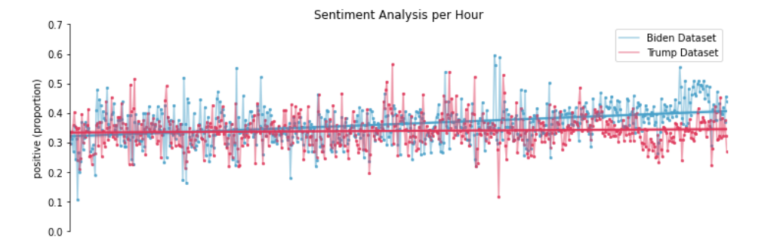
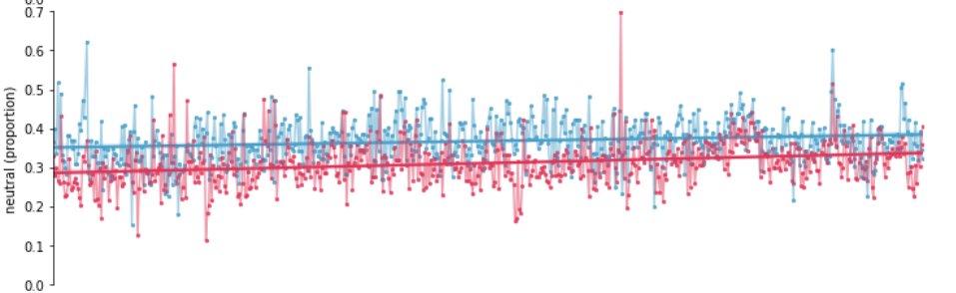
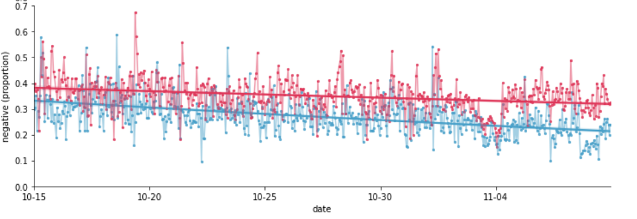
Sentiment analysis
Positive, Neutral, Negative sentiment is given and then sum those for each day and find the proportions for each sentiment group.
As time progresses the positive and neutral sentiment remains same while the negative sentiment reduces
We also see an increase in negative towards trump.

Slide 13
Conclusion
we performed EDA and sentiment analysis on the US election 2020 dataset
analysis was performed only on data that had geo-data from the USA
Most states leaned from neutral to positive towards Democrats as election date approached
The sentiment score for republicans remained neutral

